Slide 1















Slide 2















Slide 3







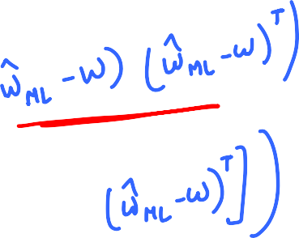

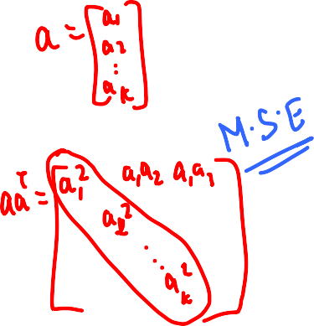





Slide 4













Slide 5















Slide 6




















Slide 7










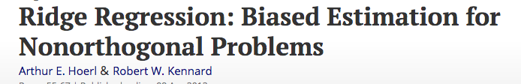

Slide 8

























Slide 9


K-fold Cross Validation
Leave one out cross validation – K = n

Slide 10













Slide 11

















Slide 12
















Slide 13





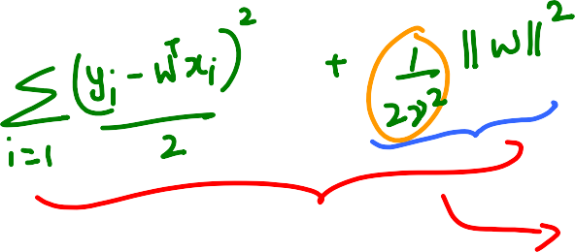










Slide 14
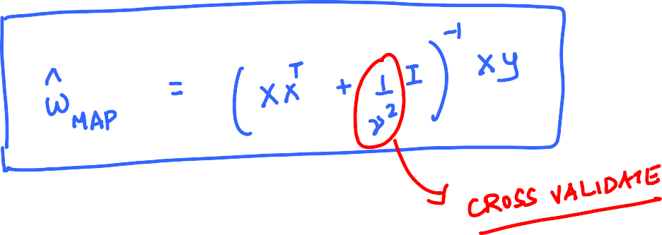

















Slide 15











Slide 16










Slide 17









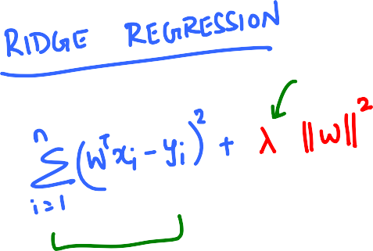





Slide 18

















Slide 19
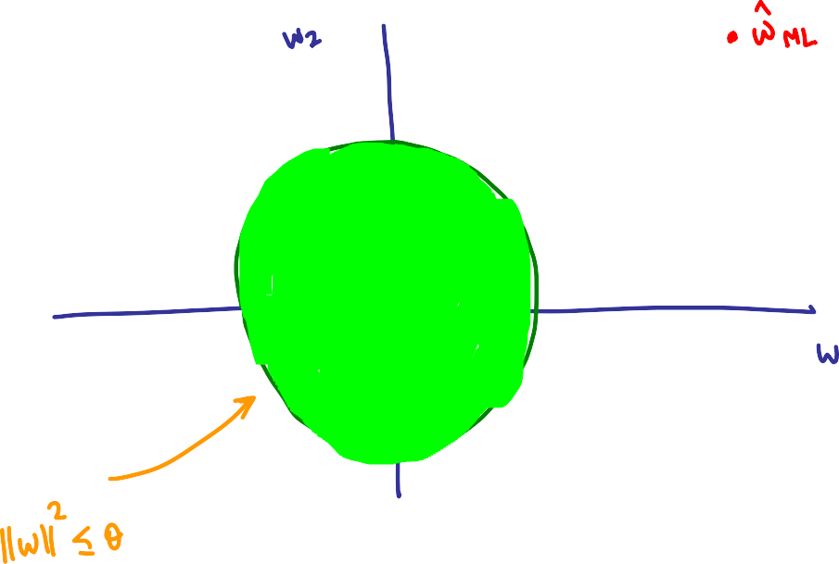













Slide 20








Slide 21











Slide 22
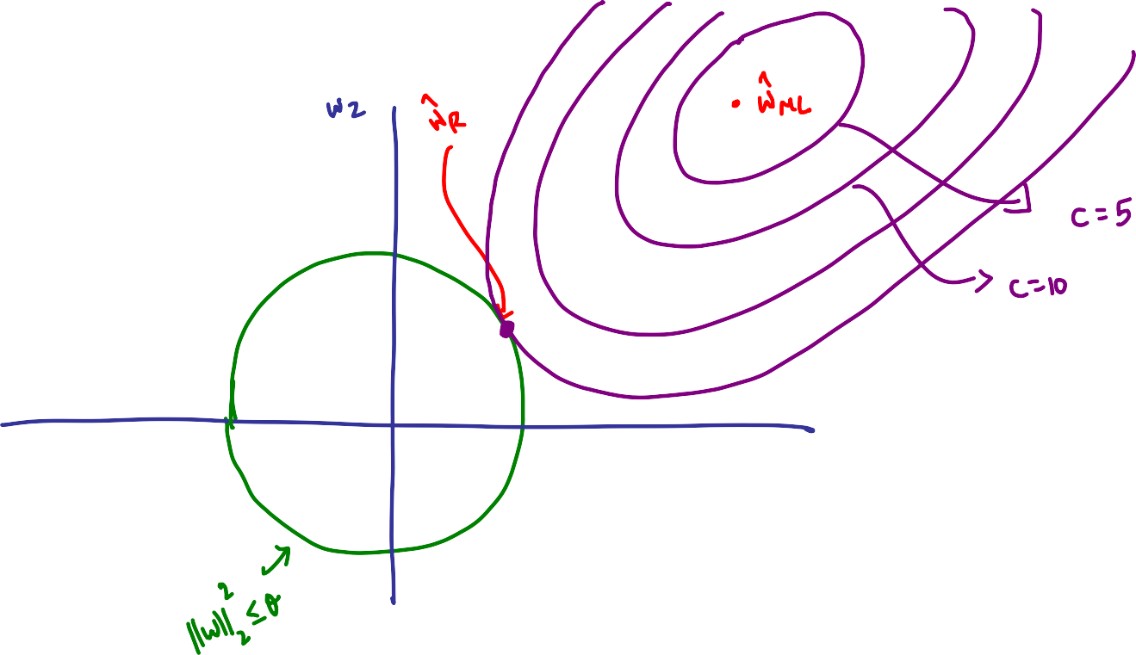






Slide 23
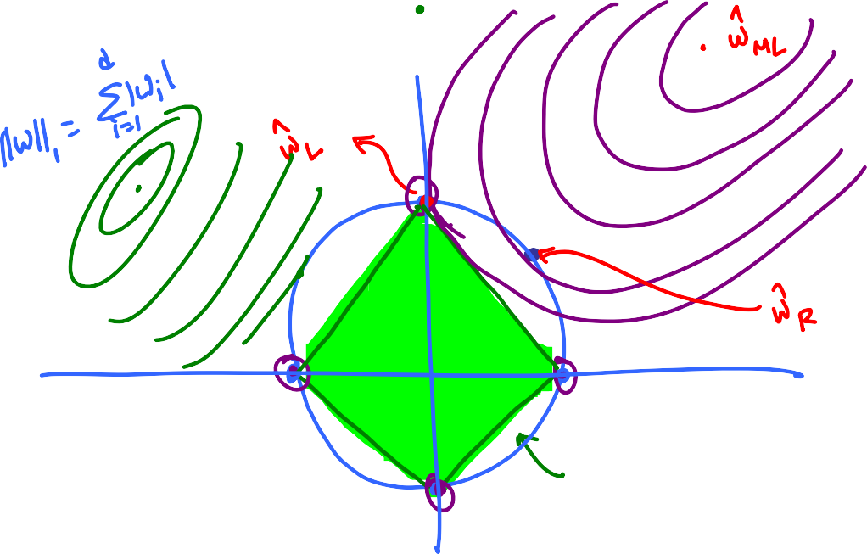







Slide 24


















Slide 25









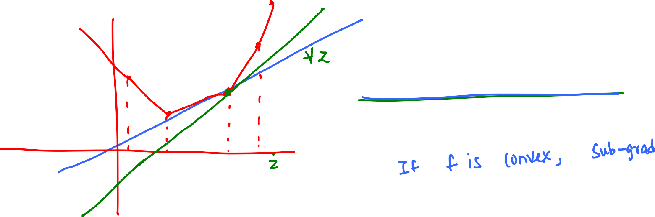





Slide 26
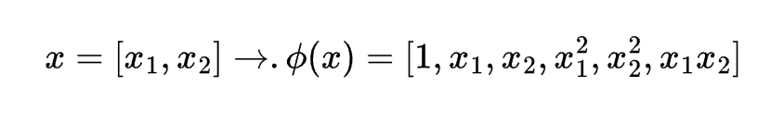
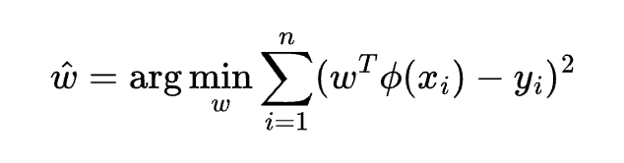
MODELING NON LINEAR RELATIONSHIPS
Key idea: Map features to higher dimension.
In the above example, learning a linear function in the higher dimension is equivalent to learning a quadratic function in the lower dimension.

Slide 27
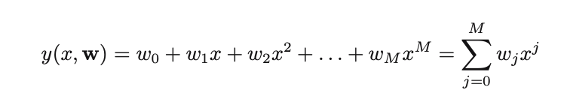
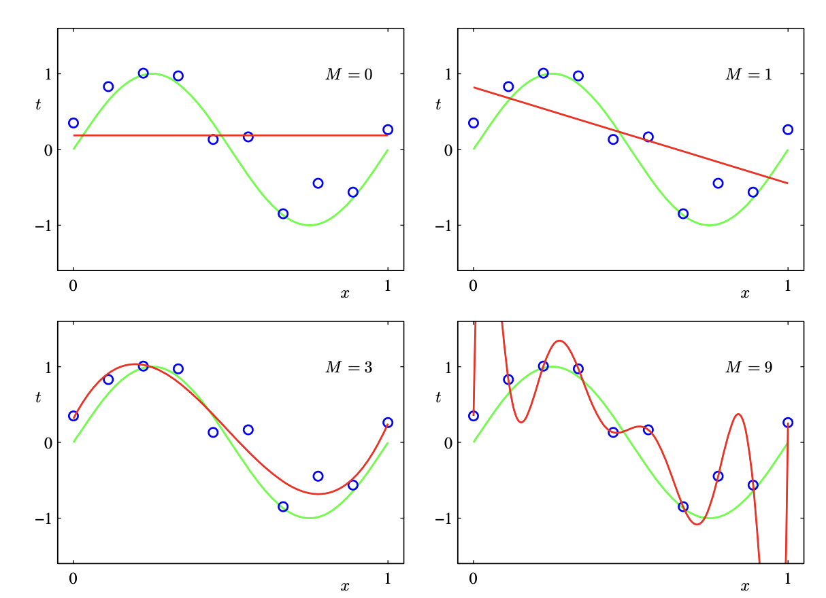

Slide 28
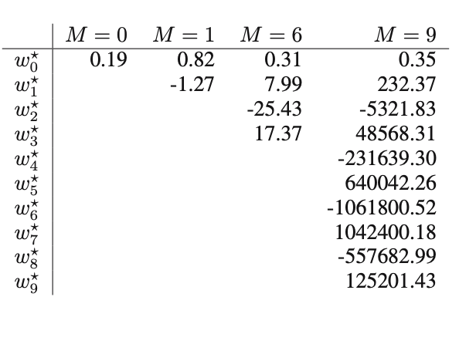
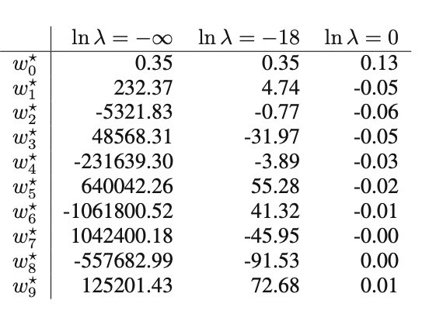
Coefficient values increases as M increases!
Regularization helps control the co-efficient values

Slide 29






















Slide 30





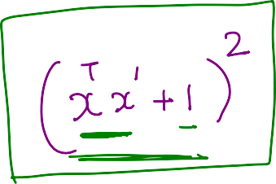






Slide 31
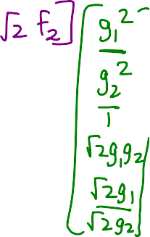





x
ϕ(x)
Hard
ϕ(x)’ ϕ(x’)
x’
ϕ(x’)

Slide 32
Summary/Questions
-> To capture non-linear relationships, one can “create” non-linear functions of
features.
-> But the number of features to create grows exponentially with the degree
of non-linearity p that we wish to capture (d^{p})
-> For d = 2 and p = 2, it appears there is a trick to get around this.
-> Is this trick general enough to be useful the general case as well?
(i.e., for any d and any p?)

Slide 33




























Slide 34





























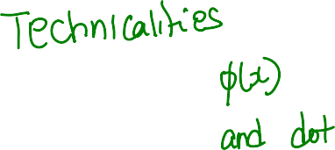







Slide 35





























Slide 36






















Slide 37



























Slide 38
How does kernel help in solving the non-linear regression problem?

Slide 39
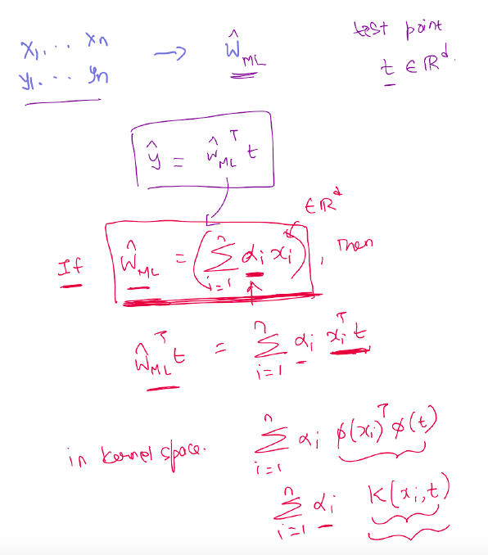

Slide 40

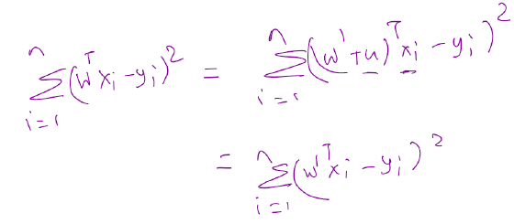
Claimed optimal w
u
x2
w’
x1
x3
w’ is also optimal

Slide 41
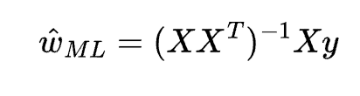
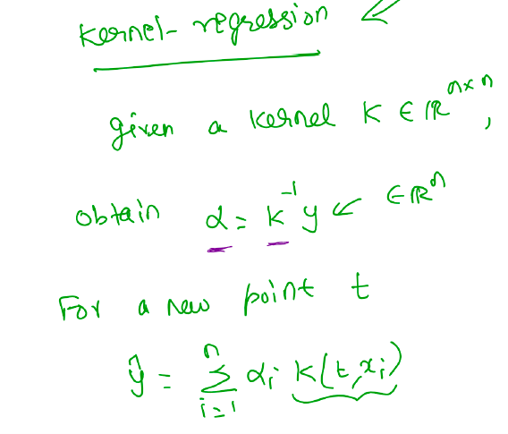
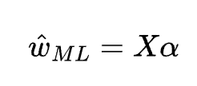
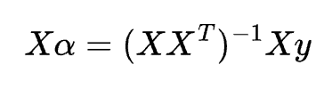
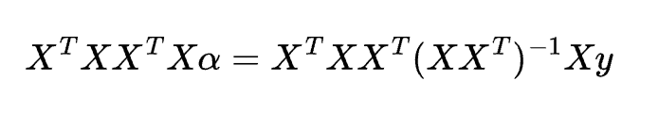
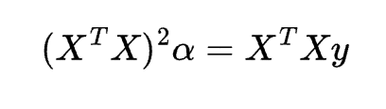
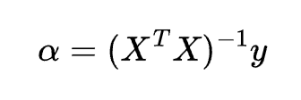
KERNEL

